Slide 1
ESC101: Introduction to Computing
f(unction)

Slide 2

A Modern Smartphone
Surf the net
Input: Web address
Output: Desired page
Book tickets
Input: userid, password, booking info, bank info
Output: Ticket
Send email
Input: email address of receiver, mail text
Output: --
Take photos
Input: --
Output: Picture
Talk (we can do that too!!)
Input: Phone number
Output: Conversation (if lucky)
…

Slide 3
Lots of related/unrelated task to perform
Divide and Conquer
Create well defined sub tasks
Work on each task independently
Development, Enhancements, Debugging
Reuse of tasks.
Email and Chat apps can share spell checker.
Phone and SMS apps can share dialer
C facilitates this using Functions

Slide 4
Function
An independent, self-contained entity of a C program that performs a well-defined task.
It has
Name: for identification
Arguments: to pass information from outside world (rest of the program)
Body: processes the arguments do something useful
Return value: To communicate back to outside world
Sometimes not required

Slide 5
Why use functions?
Example : Maximum of 3 numbers
int main(){
int a, b, c, m;
/* code to read
* a, b, c */
if (a>b){
if (a>c) m = a;
else m = c;
}
else{
if (b>c) m = b;
else m = c;
}
/* print or use m */
return 0;
}
int max(int a, int b){
if (a>b)
return a;
else
return b;
}
int main() {
int a, b, c, m;
/* code to read
* a, b, c */
m = max(a, b);
m = max(m, c);
/* print or use m */
return 0;
}
This code
can scale
easily to
handle
large
number
of inputs
(e.g.: max
of 100
numbers!)

Slide 6
Why use functions?
Break up complex problem into small sub-problems.
Solve each of the sub-problems separately as a function, and combine them together in another function.
The main tool in C for modular programming.

Slide 7
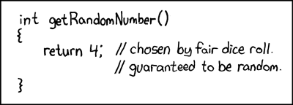
Modularity…
Source: http://xkcd.com/221/

Slide 8
Advantages of using functions
Code Reuse: Allows us to reuse a piece of code as many times as we want, without having to write it.
Think of the printf function!
Procedural Abstraction: Different pieces of your algorithm can be implemented using different functions.
Distribution of Tasks: A large project can be broken into components and distributed to multiple people.
Easier to debug: If your task is divided into smaller subtasks, it is easier to find errors.
Easier to understand: Code is better organized and hence easier for an outsider to understand it.

Slide 9
We have seen functions before
main() is a special function. Execution of program starts from the beginning of main().
scanf(…), printf(…) are standard input-output library functions.
sqrt(…), pow(…) are math functions.

Slide 10
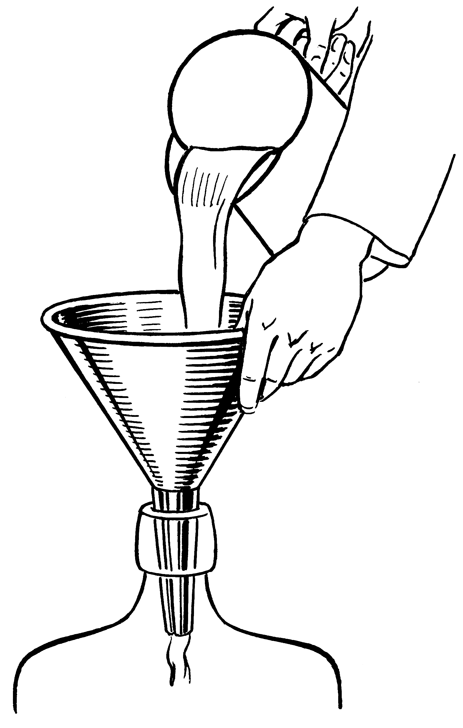
Parts of a function
Input
f
Output

Slide 11
int max (int a, int b) {
if (a > b)
return a;
else
return b;
}
2 arguments
a and b,
both of type int.
(formal args)
Return Type
Function Name
int main () {
int x;
x = max(6, 4);
printf(“%d”,x);
return 0;
}
Body of the
function, enclosed
inside { and }
(mandatory)
returns an int.
Call to the function.
Actual args are 6 and 4.

Slide 12
Function Call
A function call is an expression
feeds the necessary values to the function arguments,
directs a function to perform its task, and
receives the return value of the function.
Similar to operator application
5 + 3 is an expression of type integer that evaluates to 8
max(5, 3) is an expression of type integer that evaluates to 5

Slide 13
Function Call
Since a function call is an expression
it can be used anywhere an expression can be used
subject to type restrictions
printf(“%d”, max(5,3));
max(5,3) – min(5,3)
max(x, max(y, z)) == z
if (max(a, b)) printf(“Y”);
prints 5
evaluates to 2
checks if z is max of x, y, z
prints Y if max of a and b is not 0.

Slide 14
Returning from a function: Type
Return type of a function tells the type of the result of function call
Any valid C type
int, char, float, double, …
void
Return type is void if the function is not supposed to return any value
void print_one_int(int n) {
printf(“%d”, n);
}

Slide 15
Returning from a function: return statement
If return type is not void, then the function MUST return a value:
return return_expr;
If return type is void, the function may fall through at the end of the body or use a return without return_expr:
return;
void print_positive(int n) {
if (n <= 0) return;
printf(“%d”, n);
}
Returning through return
Fall through

Slide 16
Returning from a function: return statement
When a return statement is encountered in a function definition
control is immediately transferred back to the statement making the function call in the parent function.
A function in C can return only ONE value or NONE.
Only one return type (including void)

Slide 17

Execution of a Function: Steps
All functions in
this is route
Are busy

Slide 18
Steps when a function is called: max(6,4) in step 10a.
Allocate space for (i) return value, (ii) store return address and (iii) pass parameters.
Create a box informally called ``Return value’’ of same type as the return type of function.
Create a box and store the location of the next instruction in the calling function (main)—return address. Here it is 10 (why not 11?). Execution resumes from here once function terminates.
Parameter Passing- Create boxes for each formal parameter: a, b here. Initialize them using actual parameters, 6 and 4.
1
2
3
4
5
6
7
8
9
10
11
12
13
#include <stdio.h>
int max(int a, int b) {
if (a > b)
return a;
else
return b;
}
int main () {
int x;
x = max(6, 4);
printf(“%d”,x);
return 0;
}
10a

Slide 19
Calling max(6,4):
Allocate space for return value.
Store return address (10).
Pass parameters.
1
2
3
4
5
6
7
8
9
10
11
12
13
#include <stdio.h>
int max(int a, int b) {
if (a > b)
return a;
else
return b;
}
x
6
-1
main
Return
value
6
S
T
A C K
int main () {
int x = -1;
x = max(6, 4);
printf(“%d”,x);
return 0;
}
Return
Address
10
max
a
6
b
4
(Memory)
After completing max(), execution in main() will re-start from address 10.

Slide 20

Stack
We referred to stack.
A stack is just a part of the memory of the program that grows in one direction only.
The memory (boxes) of all variables defined as actual parameters or local variables reside on the stack.
The stack grows as functions call functions and shrinks as functions terminate.

Slide 21
Function Declaration
A function declaration is a statement that tells the compiler about the different properties of that function
name, argument types and return type of the function
Structure:
Looks very similar to the first line of a function definition, but NOT the same
has semicolon at the end instead of BODY
return_type function_name (list_of_args);

Slide 22
Function Declaration
return_type function_name (list_of_args);
Examples:
int max(int a, int b);
int max(int x, int y);
int max(int , int);
Position in program: Before the call to the function
allows compiler to detect inconsistencies
Header files (stdio.h, math.h,…) contain declarations of frequently used functions
#include <…> just copies the declarations
All 3 declarations are equivalent! Since there is no BODY here, argument names do not matter, and are optional.

Slide 23
Evaluating expressions
Associativity and Precedence precisely define what an expression means, e.g.,
a * b – c / d
is same as:
(a * b) – (c / d)
But how exactly are expressions evaluated?

Slide 24
Evaluating expression (a*b) – (c/d)
Computers evaluate one operator at a time.
Above expr may be evaluated as
t1 = c/d;
t2 = a*b;
t3 = t2 – t1;
t1, t2, t3 are temporary variables, created by the compiler (not by programmer). They are temporary, meaning, their lifetime is only until use.

Slide 25
Evaluating expression (a*b) – (c/d)
The order of evaluation of arguments for most C operators is not defined
Exceptions are && and ||
Remember: short circuit evaluation
Above expr may also be evaluated as
t1 = a*b;
t2 = c/d;
t3 = t1 – t2;
Do not depend on order of evaluation of args, except for && and ||
Same holds true for function arguments

Slide 26
int main () {
int a =4, b = 2, c = 5, d = 6;
a = a + b *c-d/a;
b = b-(c-d)/a;
return 0;}
a
13
4
b
2
c
Compiler evaluates as follows.
(Following is not a C program)
5
d
6
int main () {
int a =4, b = 2, c = 5, d = 6;
/* evaluate as a = (a + (b *c)) - (d/a);
create temporary variables t1, t2, t3
of the right types: int */
t1 = b*c;
t2 = d/a;
t3 = a + t1; /* t1 expires */
a = t3 –t2; /* t2,t3 expires */
b = b-(c-d)/a;
return 0; }
Temporary Variables
10
t1
expired
1
t2
expired
t3
14
expired
Even this statement
is not atomic.

Slide 27
int main () {
int a =4, b = 2, c = 5, d = 6;
a = a + b *c-d/a;
b = b-(c-d)*a;
printf(“%d %d”,a,b);
return 0;}
State of the program
just prior to second
assignment
a
13
b
2
15
Evaluating statement 3.
(Following is not a C program)
c
5
int main () {
int a =4, b = 2, c = 5, d = 6;
a = a + b *c-d/a;
/* evaluate b = b-((c-d)*a)
create temporary variables t1, t2
of the right types: int */
t1 =c-d;
t2 = t1*a; /* t1 expires */
b = b-t2; /* t2 expires */
printf(“%d %d”, a, b);
return 0; }
d
6
Temporary Variables
-1
t1
expired
t2
-13
expired

Slide 28
int main () {
int a =4, b = 2, c = 5, d = 6;
a = a + b *c-d/a;
b = b-(c-d)*a;
printf(“%d %d”,a,b);
return 0; }
State of the program
just prior to printf
a
13
b
15
c
5
d
6
Output
13 15
Since each function call is also an expression, statements having mix of function calls and operators are also evaluated in a similar fashion.

Slide 29
Define a factorial function.
Use to calculate ^{n}C_{k}
Let us trace the execution of main().
Add temporary variables for expressions and intermediate expressions in main for clarity.
# include <stdio.h>
int fact(int r) { /* calc. r! */
int i;
int ans=1;
for (i=0; i < r; i=i+1) {
ans = ans *(i+1);
}
return ans;
}
int main () {
int n, k;
int res;
scanf(“%d%d”,&n,&k);
res = (fact(n)/ fact(k))/fact(n-k);
printf(“%d choose %d is”,n,k);
printf(“%d\n”,res);
return 0;
}

Slide 30
int fact(int r) { /* calc. r! */
int i; int ans =1 ;
/* code here */
}
Input
4 2
S
T
A
C
K
n
4
Actual
Parameter n
t1
1
2
3
4
5
6
7
8
9
int main () {
int n, k;
int res;
scanf(“%d%d”,&n,&k);
printf(“%d choose %d is”);
printf(“%d\n”, res);
return 0;
}
k
2
t2
res
t3
main()
/* Adding temporary vars and Intermediate exprs. */
int t1, t2, t3;
t1 = fact(n);
t2 = fact(k):
t3 = fact(n-k);
res = (t1/t2)/t3;
fact()
Set up return
value and return
address
Return
value
Return
address
5
Formal parameter
gets value of
actual parameter
r
4
i
JUMP to fact ()
ans
1
Create local variables & initialize

Slide 31
# include <stdio.h>
int fact(int r) { /* calc. r! */
int i;
int ans =1 ;
for ( i=0; i < r; i=i+1) {
ans = ans *(i+1);
}
return ans;
}
We have jumped to fact() and prepared the stack for the call. Parameters are passed, return addr is stored and local variables are initialized. Now we are ready to execute.
Return
value
24
Assign to return value
S
T
A
C
K
Return
address
Now jump to return address
5
r
4
i
4
3
0
1
2
fact()
ans
1
1
2
6
24

Slide 32
1
2
3
4
5
6
7
8
9
int main () {
int n, k;
int res;
scanf(“%d%d”,&n,&k);
printf(“%d choose %d is”);
printf(“%d\n”,res);
return 0;
}
n
4
24
t1
k
2
t2
/* Adding temporary vars
and Intermediate exprs. */
int t1, t2, t3;
t1 = fact(n);
t2 = fact(k):
t3 = fact(n-k);
res = (t1/t2)/t3;
res
t3
main()
Return
value
24
We are back
in main. Local variables/formal parameters of fact() are not accessible here.
Stack is shown.
S
T
A
C
K
Return
address
5
r
4
i
4
fact()
ans
24
Only return value
is copied into t1.
Control jumps to statement 5,
since that was the return address.
After copying return value,
assume that the stack for
fact() is wiped clean.

Slide 33
1
2
3
4
5
6
7
8
9
int main () {
int n, k;
int res;
scanf(“%d%d”,&n,&k);
printf(“%d choose %d is”);
printf(“%d\n”,res);
return 0;
}
n
4
24
t1
S
T
A
C
K
k
2
t2
res
main()
t3
/* Adding temporary vars
and Intermediate exprs. */
int t1, t2, t3;
t1 = fact(n);
t2 = fact(k):
t3 = fact(n-k);
res = (t1/t2)/t3;
The next statement is another function call: fact(k). Prepare stack for new call.
Save return address.
Create box for return value.
Pass Parameters: Create boxes corresponding to formal parameters. Copy values from actual parameters.
Jump to called function.
Create/initialize local variables.
After copying return value,
assume that the stack for
fact() is wiped clean.

Slide 34
int fact(int r) { /* calc. r! */
int i; int ans =1 ;
/* code here */
}
S
T
A
C
K
n
4
24
t1
k
2
t2
1
2
3
4
5
6
7
8
9
int main () {
int n, k;
int res;
scanf(“%d%d”,&n,&k);
printf(“%d choose %d is”);
printf(“%d\n”,res);
return 0;
}
res
t3
main()
fact()
/* Adding temporary vars and Intermediate exprs. */
int t1, t2, t3;
t1 = fact(n);
t2 = fact(k):
t3 = fact(n-k);
res = (t1/t2)/t3;
Return
value
Save return address.
Create box for return value.
Pass Parameters.
Jump to fact
Return
address
6
r
2

Slide 35
S
T
A
C
K
n
4
24
t1
# include <stdio.h>
int fact(int r) { /* calc. r! */
int i;
int ans=1;
for (i=0; i < r; i=i+1) {
ans = ans *(i+1);
}
return ans;
}
k
2
t2
res
t3
main()
fact()
Return
value
2
Return
address
6
r
2
i
0
1
2
Assign value of ans to box for
return value.
Create local variables and
initialize them
ans
1
1
2
Now jump to return address

Slide 36
S
T
A
C
K
n
4
24
t1
1
2
3
4
5
6
7
8
9
int main () {
int n, k;
int res;
scanf(“%d%d”,&n,&k);
printf(“%d choose %d is”);
printf(“%d\n”,res);
return 0;
}
k
2
2
t2
res
t3
main()
/* Adding temporary vars
and Intermediate exprs. */
int t1, t2, t3;
t1 = fact(n);
t2 = fact(k):
t3 = fact(n-k);
res = (t1/t2)/t3;
fact()
Return
value
2
Return
address
6
r
2
i
2
ans
2
This is another function call. So we
prepare stack. Earlier entries for fact() is erased.

Slide 37
S
T
A
C
K
int fact(int r) { /* calc. r! */
int i; int ans =1 ;
/* code here */
}
n
4
24
t1
k
2
2
t2
1
2
3
4
5
6
7
8
9
int main () {
int n, k;
int res;
scanf(“%d%d”,&n,&k);
printf(“%d choose %d is”);
printf(“%d\n”,res);
return 0; }
res
t3
main()
fact()
Return
value
Save return address.
Create box for return value.
Pass Parameters.
Jump to fact
/* Adding temporary vars
and Intermediate exprs. */
int t1, t2, t3;
t1 = fact(n);
t2 = fact(k):
t3 = fact(n-k);
res = (t1/t2)/t3;
Return
address
7
r
2
Previous stack for fact() has
been erased.

Slide 38
S
T
A
C
K
n
4
24
t1
# include <stdio.h>
int fact(int r) { /* calc. r! */
int i;
int ans=1;
for (i=0; i < r; i=i+1) {
ans = ans *(i+1);
}
return ans;
}
k
2
t2
res
t3
main()
fact()
Return
value
2
Return
address
7
r
2
i
0
1
2
Assign value of ans to box for
return value.
Create local variables and
initialize them
ans
1
1
2
Now jump to return address

Slide 39
S
T
A
C
K
main()
n
4
24
t1
1
2
3
4
5
6
7
8
9
int main () {
int n, k;
int res;
scanf(“%d%d”,&n,&k);
printf(“%d choose %d is”);
printf(“%d\n”,res);
return 0; }
k
2
2
t2
res
6
2
t3
/* Adding temporary vars
and Intermediate exprs. */
int t1, t2, t3;
t1 = fact(n);
t2 = fact(k):
t3 = fact(n-k);
res = (t1/t2)/t3;
fact()
Return
value
2
Return
address
7
r
2
i
2
ans
2
Stack for fact() is erased after return value is copied.
4 choose 2 is 6

Slide 40
Nested Function Calls
Functions can call each other
A declaration or definition (or both) must be visible before the call
Help compiler detect any inconsistencies in function use
Compiler warning, if both (decl & def) are missing
#include<stdio.h>
int min(int, int); //declaration
int max(int, int); //of max, min
int max(int a, int b) {
return (a > b) ? a : b;
}
// a “cryptic” min, uses max
int min(int a, int b) {
return a + b – max (a, b);
}
int main() {
printf(“%d”, min(6, 4));
}

Slide 41
Predefined Functions
C has many predefined functions. We have seen scanf, printf.
To use a predefined function, the corresponding header file must be included.
Mathematical functions defined in the library math.h.
Input/Output functions in stdio.h
String functions in string.h

Slide 42
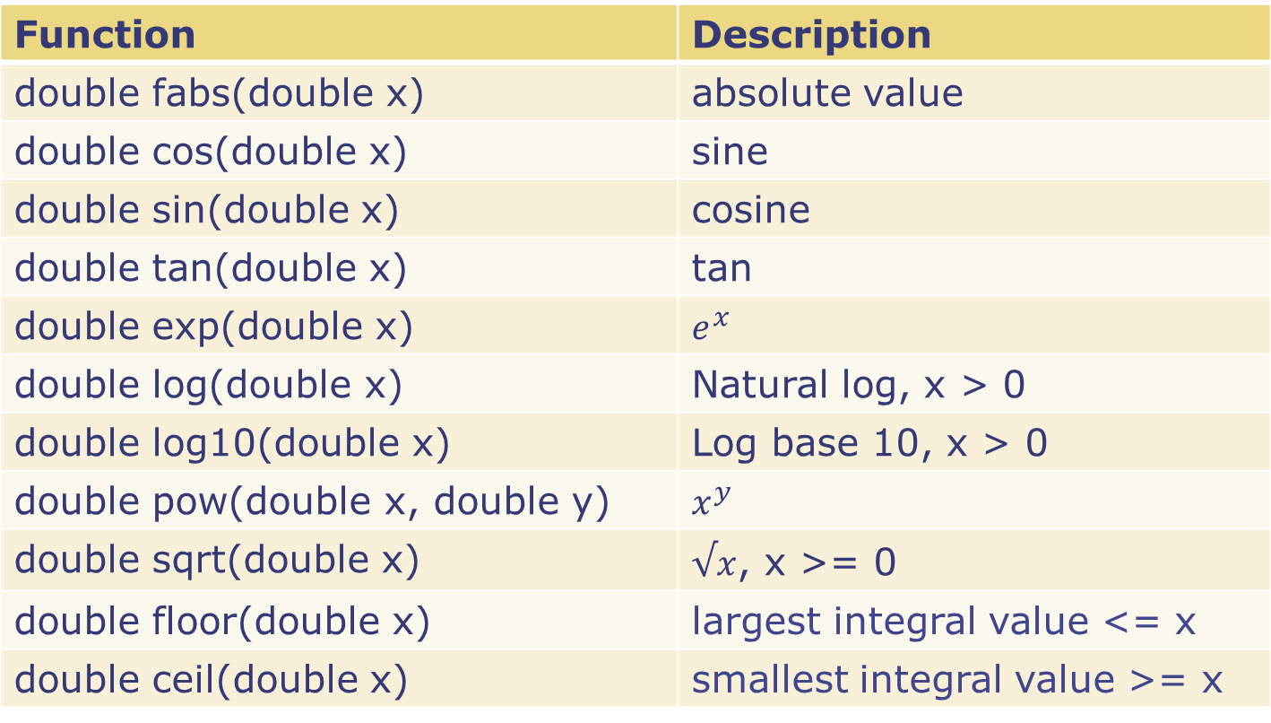
Some predefined math functions
Function | Description
double fabs(double x) | absolute value
double cos(double x) | sine
double sin(double x) | cosine
double tan(double x) | tan
double exp(double x) | $$e^{x}$$
double log(double x) | Natural log, x > 0
double log10(double x) | Log base 10, x > 0
double pow(double x, double y) | $$x^{y}$$
double sqrt(double x) | $√x$, x >= 0
double floor(double x) | largest integral value <= x
double ceil(double x) | smallest integral value >= x

Slide 43
Avoiding Common Errors
Declare functions before use.
Argument list of a function:
Provide the required number of arguments,
Check that each function argument has the correct type (or that conversion to the correct type will lose no information).

Slide 44
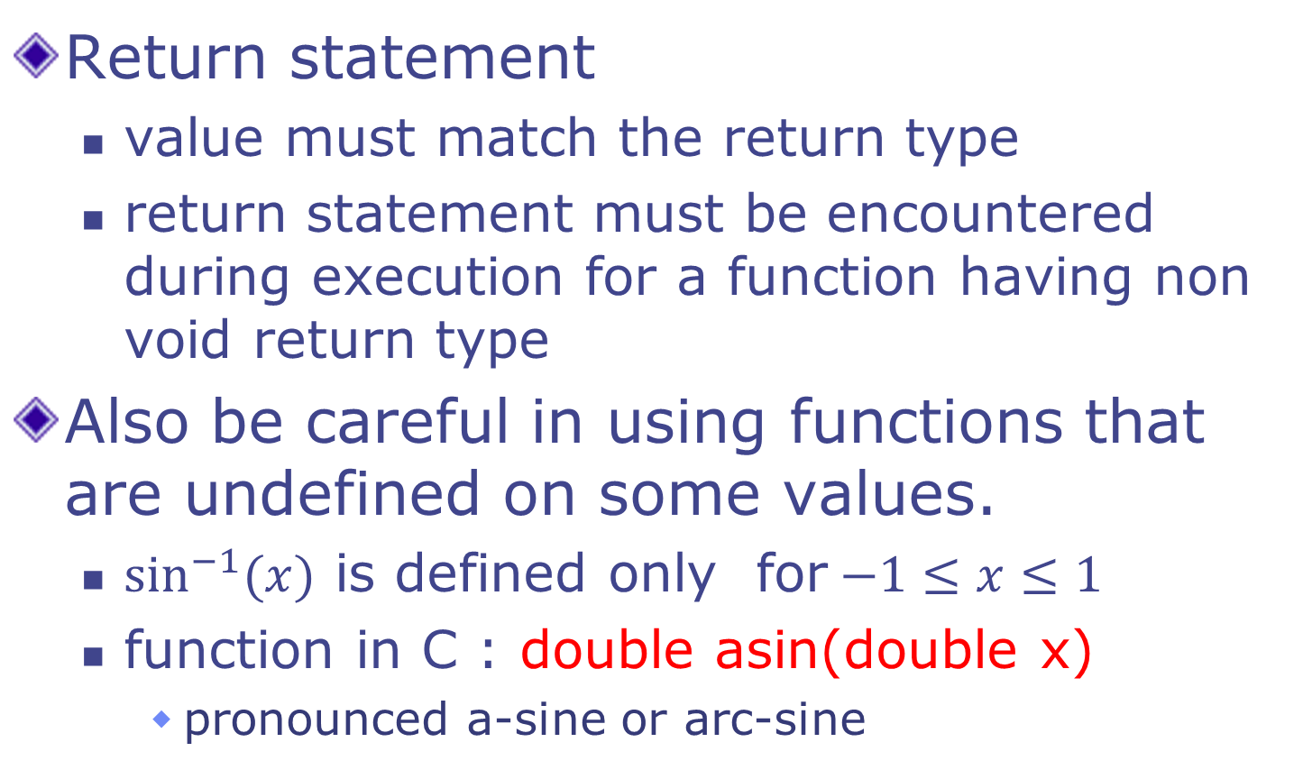
Avoiding Common Errors
Return statement
value must match the return type
return statement must be encountered during execution for a function having non void return type
Also be careful in using functions that are undefined on some values.
$\sin^{−1}{(x)}$ is defined only for$−1≤x≤1$
function in C : double asin(double x)
pronounced a-sine or arc-sine

Slide 45
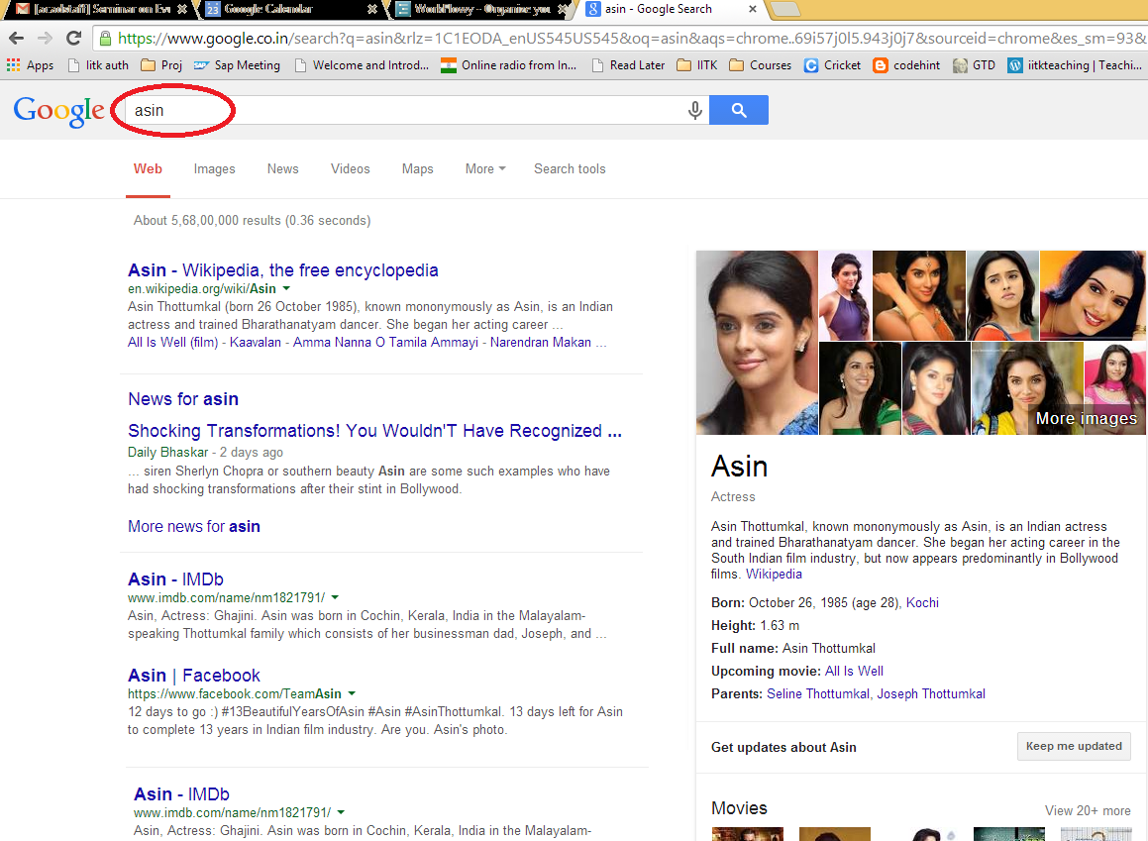

Slide 46
Scope of a Name
Functions allow us to divide a program into smaller parts
each part does a well defined task
There are other ways to partition a program
Statement blocks, Files
Scope of a name is the part of the program in which the name can be used

Slide 47
Scope of a Name
Two variables can have the same name only if they are declared in separate scopes.
A variable can not be used outside its scope.
C program has
function/block scope
file scope
global scope

Slide 48
Scope Rules: Functions
The scope of the variables present in the argument list of a function's definition is the body of that function.
The scope of any variable declared within a function is the body of the function.
int max(int a, int b) {
int m = 0;
if (a > b) m = a;
else m = b;
return m;
}
int min(int a, int b) {
int m = 0;
if (a < b) m = a;
else m = b;
return m;
}
int main() { … }
int max(int a1, int b1) {
int m1 = 0;
if (a1 > b1) m1 = a1;
else m1 = b1;
return m1;
}
int min(int a2, int b2) {
int m2 = 0;
if (a2 < b2) m2 = a2;
else m2 = b2;
return m2;
}
int main() { … }
scope of
m1, a1, b1
scope of
m2, a2, b2

Slide 49
Scope Rules : Blocks
For an identifier declared at the head of a block
Scope begins at the end of declaration
Scope ends at the end of the block
int main() {
int m = 5;
{
float m = 6.5; // shadows
printf(“%f”, m); // prints 6.5
}
printf(“%d” , m); // prints 5
}

Slide 50
Scope of a Name
Scopes can be nested
A name in inner scope “shadows” the same name, if present in outer scope
int main() {
int m = 5;
{
float m = 6.5; // shadows
printf(“%f”, m); // prints 6.5
}
printf(“%d” , m); // prints 5
}

Slide 51
Global Variable
Variable declared outside every function definition
Can be accessed by all functions in the program that follow the declaration
Also called External variable
What if a variable is declared inside a function that has the same name as a global variable?
The global variable is “shadowed” inside that particular function only.

Slide 52
Global Variables
#include<stdio.h>
int g=10, h=20;
int add(){
return g+h;
}
void fun1(){
int g=200;
printf("%d\n",g);
}
int main(){
fun1();
printf("%d %d %d\n",
g, h, add());
return 0;
}
The variable g and h have been defined as global variables.
The use of global variables is normally discouraged. Use local variables of functions as much as possible.
Global variables are useful for defining constants that are used by different functions in the program.
200
10 20 30

Slide 53
Global Variables: example
const double PI = 3.14159;
double circum_of_circle(double r) {
return 2 * PI * r; }
double area_of_circle (double r) {
return PI * r * r;
}
defines PI to be of type double with value 3.14159. Qualified by const, which means that PI is a constant. The value inside the box associated with PI cannot be changed anywhere.

Slide 54
Static Variables
We have seen two kinds of variables: local variables and global variables.
There are static variables too.
int f () {
int ncalls = 0;
ncalls = ncalls + 1;
/* track the number of
times f() is called */
… body of f() …
}
GOAL: count number of calls to f()
SOLUTION: define ncalls as a static variable inside f().
It is created as an integer box the first time f() is called.
Once created, it never gets destroyed, and retains its value across invocations of f().
It is like a global variable, but visible only within f().
Static variables are not allocated on stack. So they are not destroyed when f() returns.
int f () {
static int ncalls = 0;
ncalls = ncalls + 1;
/* track the number of
times f() is called */
… body of f() …
}
int ncalls = 0;
int f () {
ncalls = ncalls + 1;
/* track the number of
times f() is called */
… body of f() …
}
Use a local variable?
gets destroyed every time f returns
Use a global variable?
other functions can change it! (dangerous)

Slide 55
Summary
Global Variables
Visible everywhere
Live everywhere (never destroyed)
Local Variables
Visible in scope
Live in scope (destroyed at the point where we leave the scope)
Static Variables
Visible in Scope
Live everywhere! (but can not be accessed outside scope)

Slide 56
Quiz 5: Argument Passing
// swapping a and b
void swap(int a, int b){
int temp;
temp = a;
a = b;
b = temp;
printf("a=%d b=%d\n", a, b);
}
int main(){
int a=10, b=15;
printf("a=%d b=%d\n", a, b);
swap(a, b);
printf("a=%d b=%d\n", a, b);
return 0;
}
What is the output of the program?
(fill the blanks)
OUTPUT
a=___ b=___
a=___ b=___
a=___ b=___
10
15
10
15
15
10

